Slide 1
Requirements
Svyatoslav Dyuhanchuk

Slide 2
Requirements
Requirement: A condition or capability needed by a user to solve a problem or achieve an objective that must be met or possessed by a system or system component to satisfy a contract, standard, specification, or other formally imposed document.
Requirements are a specification of what should be implemented, but not how.

Slide 3
Requirements Types
Functional:
Business requirements
User requirements
Functional requirements
Nonfunctional:
Physical environment
Performance
Documentation
Quality attributes

Slide 4
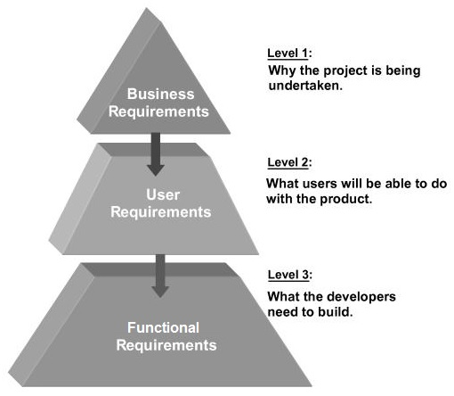
Requirements Levels

Slide 5
Levels of requirements
1. Business requirements (Vision and Scope document)
Example:
“We need a tool for selecting commercial data from different sources and converting it to easy-to-read forms.”
2. User requirements (User Stories, Use Case)
Example:
“When the user logs into the system the welcome page should be opened”.
3. Functional and non-functional requirements (Specification):
Example:
“The device should check all valid sources during installation. All invalid sources must be visible but disabled for a regular user.”

Slide 6
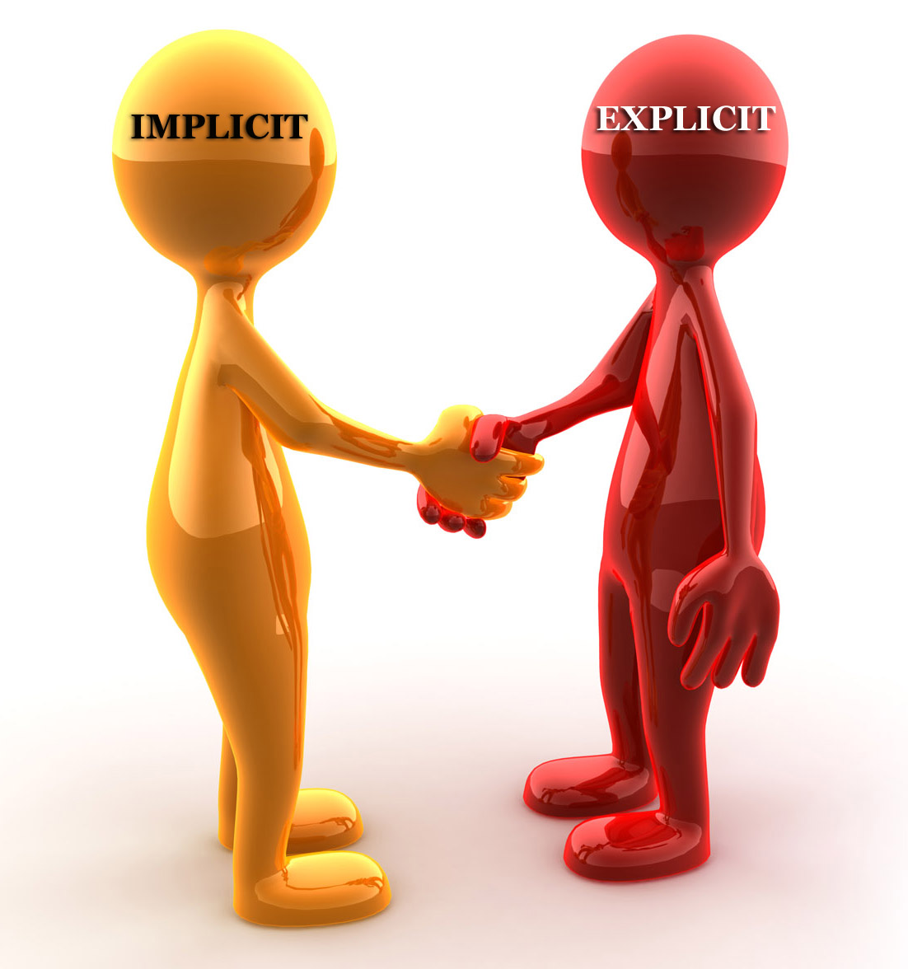
Implicit and Explicit
Clearly defined and documented
Hidden or ‘assumed’ and not stated explicitly

Slide 7
Characteristics of Good requirements
Bad Example | Good Example
REQ1: All requirements should developer and tested. Does the requirement present some business need?
Necessary

Slide 8
Characteristics of Good requirements
Bad Example | Good Example
REQ3: On loss of power, the battery backup must support operations. For how long ? | REQ3: On loss of power, the battery backup must support operations for 20 minutes.
Complete

Slide 9
Characteristics of Good requirements
Bad Example | Good Example
REQ4: The electronic batch records shall be Part 11 compliant. REQ47: An on-going training program for 21 CFR Part 11 needs to be established at the sites. Do these refer to the same regulation or different ones? | REQ4: The electronic batch records shall be 21 CFR Part 11 compliant. REQ47: An on-going training program for 21 CFR Part 11 needs to be established at the site.
Consistent

Slide 10
Characteristics of Good requirements
Bad Example | Good Example
REQ2: All screens should appear on monitor quickly How quickly? | REQ2: When the user accesses any screen, it must appear on the monitor within 2 seconds.
Unambiguous

Slide 11
Characteristics of Good requirements
Bad Example | Good Example
REQ7: The system must be user friendly. How should we measure user friendliness? | REQ7: The user interface shall be menu driven. It shall provide dialog boxes, help screens, radio buttons, dropdown list boxes, and spin buttons for user inputs.
Verifiable

Slide 12
Characteristics of Good requirements
Necessary
Complete
Consistent
Unambiguous
Verifiable

Slide 13
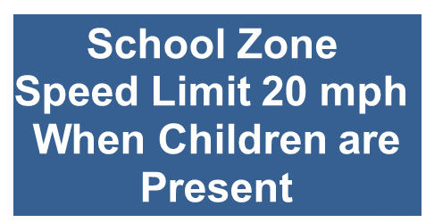
Examples
How do we know who is “children”? – Complete.
Only when school works? – Complete .
What does “present” mean – on a sidewalk, behind a fence? – Unambiguous.
Because of this requirement is not verifiable.
If some of the qualities are missing, there is a problem with the requirement.
And there will be bugs.

Slide 14
Examples
The system shall work with any browser.
The system shall respond quickly to user clicks.
The system shall work with Firefox.
The system shall work with IE.
The system shall respond within 10ms to any user click.

Slide 15
Types of documents through which requirements can be communicated

Slide 16
Software Requirements Specification
SRS – it’s a description of a software system to be developed, laying out functional and non-functional requirements
Contents of SRS (Section 5 of IEEE 830)
Introduction
General description of the software product
Specific requirements (detailed)
Additional information such as appendixes and index, if necessary

Slide 17
User Stories
User Stories - are short, simple description of a feature told from the perspective of the person who desires the new capability, usually a user or customer of the system. They typically follow a simple template:
As a <type of user>, I want <some goal> so that <some reason>.

Slide 18
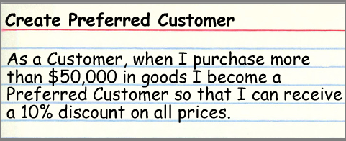
Examples of user story
As a administrator, I can:
Add new user to database
Delete new user from database
Verify count of registered users
Verify count of users who have discount

Slide 19
Use Cases
Use case is a list of steps, typically defining interactions between a role (known in UML as an "actor") and a system, to achieve a goal. The actor can be a human or an external system.
Might be represented in two major forms:
Diagram
Structural textual description

Slide 20
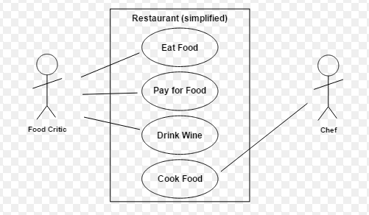
Use Case Diagram
A Use Case Diagram for the interaction of a client (the actor) and a restaurant (the system)

Slide 21
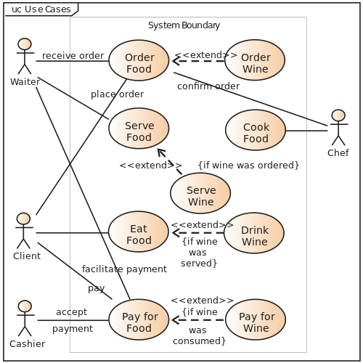
Use Case Diagram

Slide 22


Slide 23
About testing
Test planning
Analyze requirements
Grooming

Slide 24
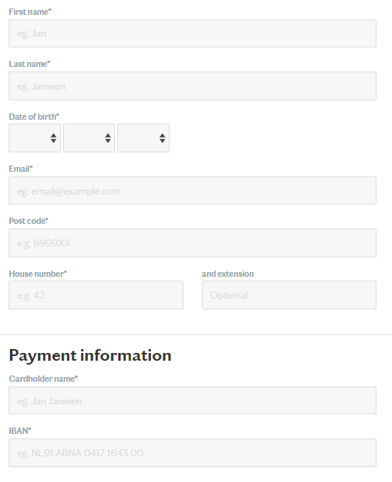
Task

